Slide 1
Text Summarization - LexRank
Text Summarization - LexRank
Week 11, Lecture 1

Slide 2
Text Summarization
What is a summary?
A summary is a text that is produced from one or more texts, that contains a significant portion of the information in the original text(s), and that is no longer than half of the original text(s). (Hovy, 2008)
What is text summarization?
Text summarization is the process of distilling the most important information from a source (or sources) to produce an abridged version for a particular user or task. (Mani and MayBury, 2001)
Humans have an incredible capacity to condense information down to the critical bit.
“He said he is against it.”
Calvin Coolidge, on being asked what a clergyman preaching on sin said.
Text Summarization - LexRank
Week 11, Lecture 1
2 / 10

Slide 3
Automatic Text Summarization
Goal of a Text Summarization System
To give an overview of the original document in a shorter period of time.
Summarization Applications
outlines or abstracts of any document, news article etc.
summaries of email threads
action items from a meeting
simplifying text by compressing sentences
Text Summarization - LexRank
Week 11, Lecture 1
3 / 10

Slide 4
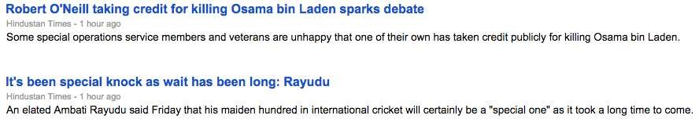
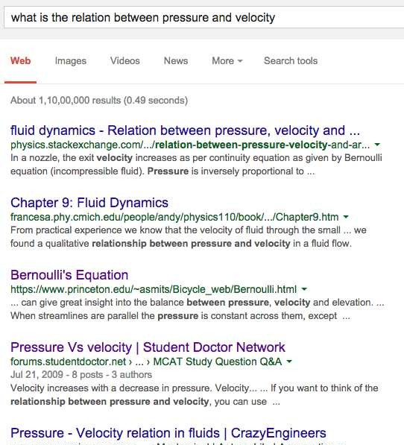
Application: Generating Snippets
Text Summarization - LexRank
Week 11, Lecture 1
4 / 10

Slide 5
Automatic Text Summarization
Genres of Summary
Extract vs. Abstract
. . .lists fragments of text vs. re-phrases content coherently.
Single document vs. Multi-document
. . .based on one text vs. fuses together many texts.
Generic vs. Query-focused
. . .provides author’s view vs. reflects user’s interest.
Query-focused summarization can be thought of as a complex question answering system
Text Summarization - LexRank
Week 11, Lecture 1
5 / 10

Slide 6
Summarization: Main stages
Content Selection
Choose sentences to extract from the document
Information Ordering
Choose an order to place them in the summary
Sentence realization
Simplify the sentences
Removing Redundancy
Increase diversification by removing redundant sentences
The most basic algorithm only does the first stage, content selection.
Text Summarization - LexRank
Week 11, Lecture 1
6 / 10

Slide 7
Unsupervised content selection; Luhn (1958)
Intuition
Choose sentences that have salient or informative words
Two approaches to define salient words
tf-idf: weigh each word w_{i} in document j by tf-idf
weight(w_{i}) = tf_{ij} × idf_{i}
Topic signatures: choose a smaller set of salient words, specific to that domain
weight(w_{i}) = 1 if w_{i} is a specific term (use mutual information)
Text Summarization - LexRank
Week 11, Lecture 1
7 / 10

Slide 8
Unsupervised content selection; Luhn (1958)
Intuition
Choose sentences that have salient or informative words
Two approaches to define salient words
tf-idf: weigh each word w_{i} in document j by tf-idf
weight(w_{i}) = tf_{ij} × idf_{i}
Topic signatures: choose a smaller set of salient words, specific to that domain
weight(w_{i}) = 1 if w_{i} is a specific term (use mutual information)
Weighing a sentence
1
|S| ∑
weight(s) = weight(w)
w∈S
Text Summarization - LexRank
Week 11, Lecture 1
7 / 10

Slide 9
LexRank: A Graph-based approach
Text Document
Computation is a process following a well defined model ...
A computation can be seen as a purely physical phenomena ...
...
processing
S₁ → {(computation, 0.1),(process, 0.15),...}
S₂ → {(computation, 0.1),(seen, 0.05),...}
S₃ → . . .
Machine-readable format
Document Representation
Underlying Hypothesis
Sentences that convey the theme of the document are more similar to each other
S₁
S₂
Si
S₃
Document
Finding the most salient sentences
Text Summarization - LexRank
Week 11, Lecture 1

Slide 10
Sentence Centrality Measure
Finding the most salient sentences
A sentence similarity function is used to calculate the edge weights.
M12
 | S1 |  | S2 |  |  0 0 . | 0.5 | 0.0 | 0.4 | 0 1  .
 |  |  |  |  |  0.5 | 0.0 | 0.5 | 0.0 | 0.0  
S3 |  | M34 |  | S4 | M˜ =  0.0  0.4 0.3 | 0.5 0.0 0.0 | 0.0 0.4 0.0 | 0.5 0.0 0.7 | 0.0  0 2  .  0.0


S5
Text Summarization - LexRank
Week 11, Lecture 1
9 / 10

Slide 11
Sentence Centrality Measure
Finding the most salient sentences
PageRank based algorithm is used to compute the sentence centrality vector I.
M12
 | S1 |  | S2 |  |  0 0 . | 0.5 | 0.0 | 0.4 | 0 1  .
 |  |  |  |  |  0.5 | 0.0 | 0.5 | 0.0 | 0.0  
S3 |  | M34 |  | S4 | M˜ =  0.0  0.4 0.3 | 0.5 0.0 0.0 | 0.0 0.4 0.0 | 0.5 0.0 0.7 | 0.0  0 2  .  0.0


S5
1 − µ
+
∑ k
I = µ · I · M˜
j
k,j
|S|
∀k=/ j
I = 0.22 0.18 0.2 0.3 0.1
Text Summarization - LexRank
Week 11, Lecture 1
9 / 10

Slide 12
Removing Redundant Sentences
Maximal Marginal Relevance
An iterative method for content selection from a selected list of important sentences
Iteratively choose the best sentence to insert in the summary that is minimally redundant with the summary so far (Sum)
Inf (s)_{MMR} = max_{s∈D}(Inf (s) − λ· sim(s, Sum))
where Inf (s) denotes the informativeness score of a sentence
Text Summarization - LexRank
Week 11, Lecture 1
10 / 10

Slide 13
Optimization Based Approaches for Summarization
Optimization Based Approaches for Summarizati
on
Week 11, Lecture 2
1 / 8

Slide 14
Global Inference
Let us define document D with t_{n} textual units
D = t₁, t₂, . . . , t_{n−1}, t_{n}
Let Rel(i) be the relevance of t_{i} to be in the summary Let Red(i, j) be the redundancy between t_{i} and t_{j}
Let l(i) be the length of t_{i}
Optimization Based Approaches for Summarizati
on
Week 11, Lecture 2
2 / 8

Slide 15
Inference Problem
The inference problem is to select a subset S of textual units from D such that summary score of S, i.e., s(S), is maximized.
S = argmax_{S⊆D} " ∑ Rel(i) −
∑
Red(i, j)#
such that ∑ l(i) ≤ K, where k denotes the maximum length of the summary ^{ti∈S}
ti∈S ti,tj∈S,i<j
Optimization Based Approaches for Summarizati
on
Week 11, Lecture 2
3 / 8

Slide 16
A Greedy Solution
1. Sort D so that Rel(i) > Rel(i + 1)∀i 2. S = {t₁}
3.
4.
5.
6. return S
while ∑_{ti∈S} l(i) < K
t_{j} = argmax_{tj∈D−S} s(S ∪ {t_{j}})
S = S ∪ {t_{j}}
Optimization Based Approaches for Summarizati
on
Week 11, Lecture 2
4 / 8

Slide 17
Integer Linear Programming (ILP)
Greedy algorithm is an approximate solution Use exact solution algorithms with ILP
ILP is a constrained optimization problem Many solvers on the web
Define the constraints based on relevance and redundancy for summarization
Optimization Based Approaches for Summarizati
on
Week 11, Lecture 2
5 / 8

Slide 18
Sentence Level ILP Formulation
Optimization Function
maximize ∑_{i} αiRel(i) − ∑_{i<j} αijRed(i, j)
Constraints
such that ∀i, j:
α_{i}, α_{ij} ∈ {0, 1}
∑_{i} αil(i) ≤ K α_{ij} − α_{i} ≤ 0 α_{ij} − α_{j} ≤ 0
α_{i} + α_{j} − α_{ij} ≤ 1
Is generic enough
Depending on your task, you can define your own optimization function and constrains.
Optimization Based Approaches for Summarizati
on
Week 11, Lecture 2
6 / 8

Slide 19
The next steps: Sentence Ordering
Chronological ordering: the simplest method
List the sentences in the order, they appear in the document
Coherence
Choose orderings that make neighboring sentences similar (by cosine)
Choose orderings in which neighboring sentences discuss the same entity
Topical ordering
Learn the ordering of topics in the source documents
Optimization Based Approaches for Summarizati
on
Week 11, Lecture 2
7 / 8

Slide 20
The next steps: Simplifying Sentences
Parse sentences, use rules to decide which modifiers to prune
Initial adverbials: For example, on the other hand, as a matter of fact, at this point, ...
PPs without named entities: The commercial fishing restrictions in Washington will not be lifted unless the salmon population increases [PP to a sustainable number]
Attribution clauses: Rebels agreed to talks with government officials,
international observers said Tuesday
Appositives: Rajan, 28, an artist who was living at the time in Philadelphia, found the inspiration in the back of city magazines
Optimization Based Approaches for Summarizati
on
Week 11, Lecture 2
8 / 8

Slide 21
Summarization: Evaluation
Summarization: Evaluation
Week 11, Lecture 3

Slide 22

System Evaluation
Evaluation Criteria
S2 . . ..
S5 . . .
. . .
System-generated summary
comparison
Reference summary
System Evaluation
ROUGE
Recall Oriented Understudy for Gisting Evaluation Not as good as human evaluation but much more convenient
Toolkit available for download.
Summarization: Evaluation
Week 11, Lecture 3
2 / 5

Slide 23
ROUGE for evaluation
Given a document D, and an automatic summary X:
Have N humans produce a set of reference summaries of D (N ≥ 1) Run system, giving automatic summary X
What percentage of the n-grams from the reference summaries appear in
X?
☛ ✟
_{ROUGE − 2 =} ∑S∈{RefSums} ∑bi−gram∈S ^{Count}match^{(bi−gram)}
∑S∈{RefSums} ∑bi−gram∈S ^{Count(bi−gram)}
✡ ✠
Summarization: Evaluation
Week 11, Lecture 3

Slide 24
ROUGE Example
Reference Summaries
Human 1: water spinach is a green leafy vegetable grown in the tropics.
Human 2: water spinach is a semi-aquatic tropical plant grown as a vegetable.
Human 3: water spinach is a commonly eaten leaf vegetable of Asia
System Summary
water spinach is a leaf vegetable commonly eaten in tropical areas of Asia.
Summarization: Evaluation
Week 11, Lecture 3
4 / 5

Slide 25
ROUGE Example
Reference Summaries
Human 1: water spinach is a green leafy vegetable grown in the tropics.
Human 2: water spinach is a semi-aquatic tropical plant grown as a vegetable.
Human 3: water spinach is a commonly eaten leaf vegetable of Asia
System Summary
water spinach is a leaf vegetable commonly eaten in tropical areas of Asia.
ROUGE-2
3 + 3 + 6
₁₀ ₊ ₁₀ ₊ ₉ = 12/29 = 0.413
Summarization: Evaluation
Week 11, Lecture 3
4 / 5

Slide 26
Further Discussions
Multi-document summarization Query-specific summarization Abstractive summarization
Summarization: Evaluation
Week 11, Lecture 3
5 / 5

Slide 27
Text Classification - I
Text Classification - I
Week 11, Lecture 4

Slide 28
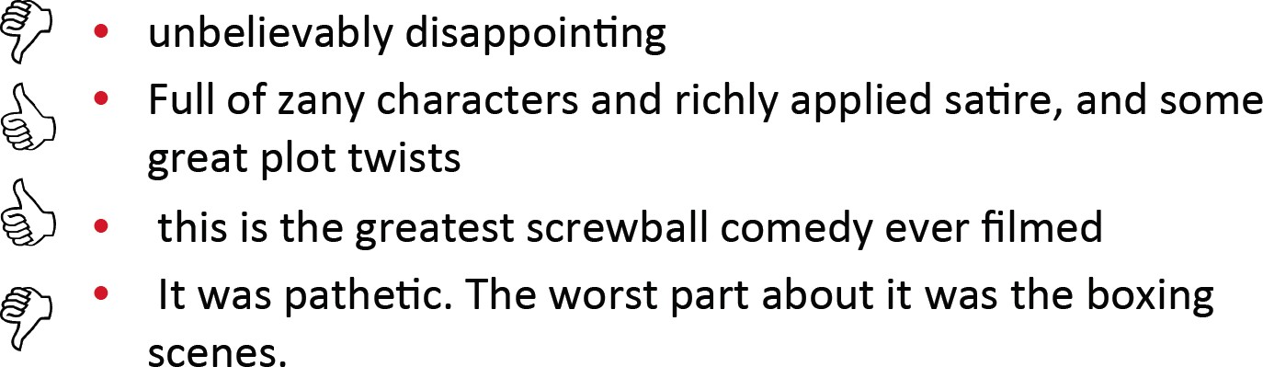
Example: Positive or negative movie review?
Text Classification - I
Week 11, Lecture 4

Slide 29
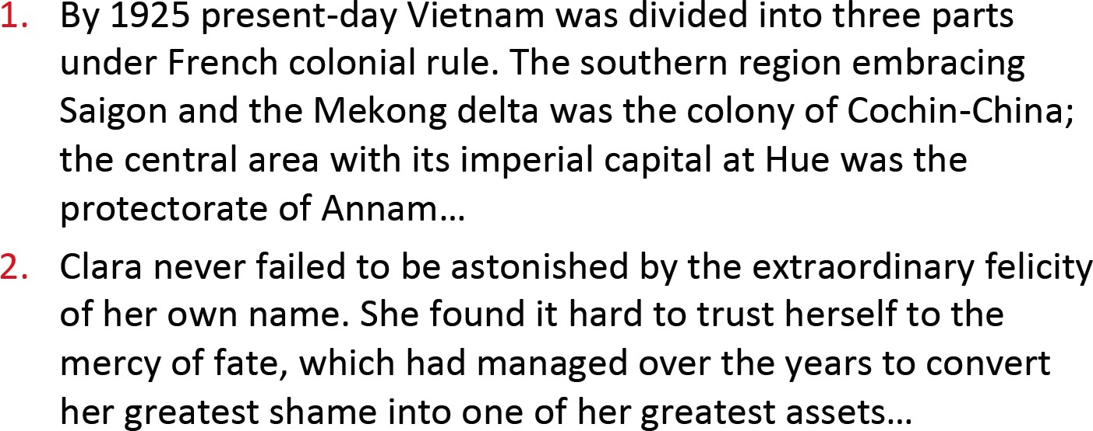
Example: Male or Female Author?
Text Classification - I
Week 11, Lecture 4

Slide 30
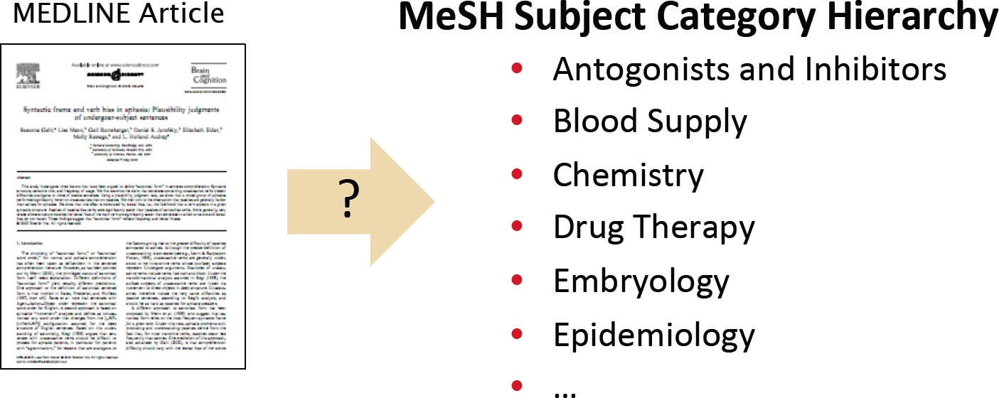
Example: What is the subject of this article?
Text Classification - I
Week 11, Lecture 4

Slide 31
Taxt Classification
Assigning subject categories, topics, or genres Spam detection
Authorship identification Age/gender identification Language identification Sentiment analysis
...
NPTEL
Text Classification - I
Week 11, Lecture 4

Slide 32
Text classification: problem definition
Input
A document d
A fixed set of classes C = {c₁, c₂, . . . , c_{n}}
Output
A predicted class c ∈ C
Text Classification - I
Week 11, Lecture 4
6 / 14

Slide 33
Classification Methods: Hand-coded rules
Rules based on combinations of words or other features
Spam
black-list-address OR (“dollars” AND “have been selected”)
Pros and Cons
Accuracy can be high if rules carefully refined by expert, but building and maintaining these rules is expensive.
Text Classification - I
Week 11, Lecture 4
7 / 14

Slide 34
Classification Methods: Supervised Machine Learning
Naïve Bayes Logistic regression
Support-vector machines
...
Text Classification - I
Week 11, Lecture 4

Slide 35
Naïve Bayes Intuition
Simple classification method based on Bayes’ rule
Relies on very simple representation of document - Bag of words
Text Classification - I
Week 11, Lecture 4

Slide 36
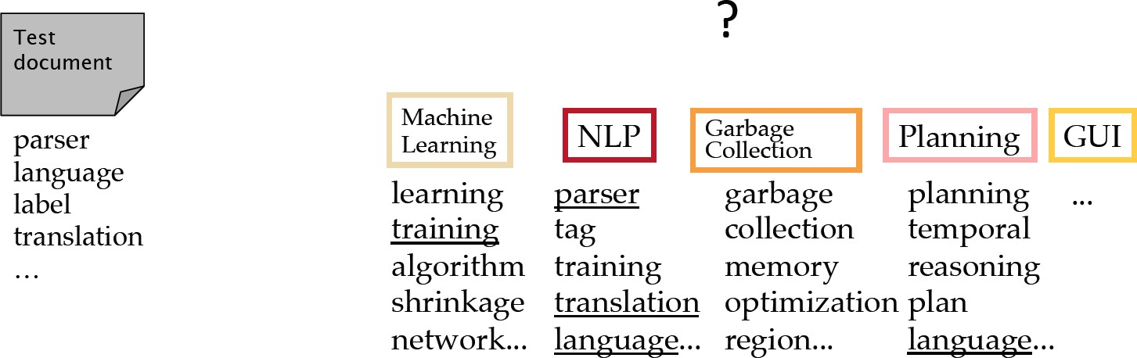
Bag of words for document classification
Text Classification - I
Week 11, Lecture 4

Slide 37
Bayes’ rule for documents and classes
For a document d and a class c
P(d|c)P(c)
P(c|d) =
P(d)
Naïve Bayes Classifier
c_{MAP} = argmax P(c|d)
c∈C
= argmax P(d|c)P(c)
c∈C
= argmax P(x₁, x₂, . . . , x_{n}|c)P(c)
c∈C
Text Classification - I
Week 11, Lecture 4
11 / 14

Slide 38
Naïve Bayes classification assumptions
P(x₁, x₂, . . . , x_{n}|c)
Bag of words assumption
Assume that the position of a word in the document doesn’t matter
Conditional Independence
Assume the feature probabilities P(x_{i}|c_{j}) are independent given the class c_{j}.
P(x₁, x₂, . . . , x_{n}|c) = P(x₁|c) · P(x₂|c) . . . P(x_{n}|c)
c_{NB} = argmax P(c) ∏ P(x|c)
c∈C
x∈X
Text Classification - I
Week 11, Lecture 4
12 / 14

Slide 39
Learning the model parameters
Maximum Likelihood Estimate
_{Pˆ(cj) =} doc − count(C = c_{j})
Ndoc
count(w , c )
ˆ
i j
P(w |c ) =
∑ count(w, c_{j})
i j
w∈V
Problem with MLE
Suppose in the training data, we haven’t seen the word “fantastic”, classified in the topic ‘positive’.
P^{ˆ}(fantastic|positive) = 0
ˆ
∏ i
c = argmax P(c
c
ˆ
NB
) P(x |
c)
x∈X
Text Classification - I
Week 11, Lecture 4
13 / 14

Slide 40
Laplace (add-1) smoothing
count(w , c) + 1
ˆ
i
P(w |c
) =
∑ (count(w, c) + 1)
i
w∈V
count(w_{i}, c) + 1
=
( ∑ (count(w, c)) + |V|
w∈V
Text Classification - I
Week 11, Lecture 4
14 / 14

Slide 41
Text Classification - II
Pawan Goyal
CSE, IIT Kharagpur
Week 11, Lecture 5
Text Classification - II
Week 11, Lecture 5

Slide 42
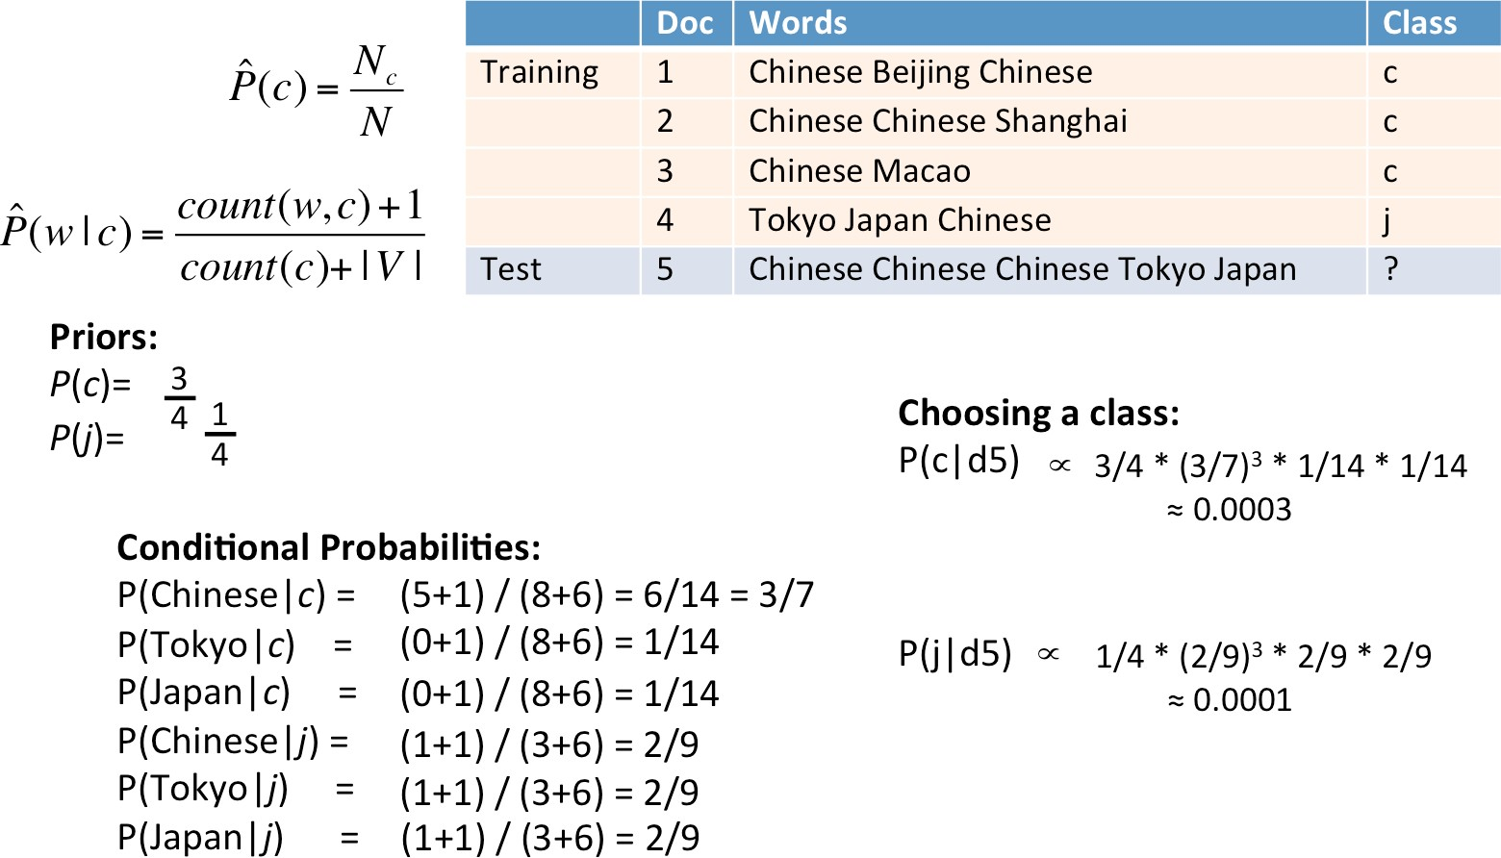
A worked example
Text Classification - II
Week 11, Lecture 5

Slide 43
Naïve Bayes and Language Modeling
In general, NB classifier can use any feature
URL, email addresses, dictionaries, network features
But if we use only the word features and all the words in the text
Naïve Bayes has an important similarity to language modeling.
Each class can be thought of as a separate unigram language model.
Text Classification - II
Week 11, Lecture 5
8 / 15

Slide 44
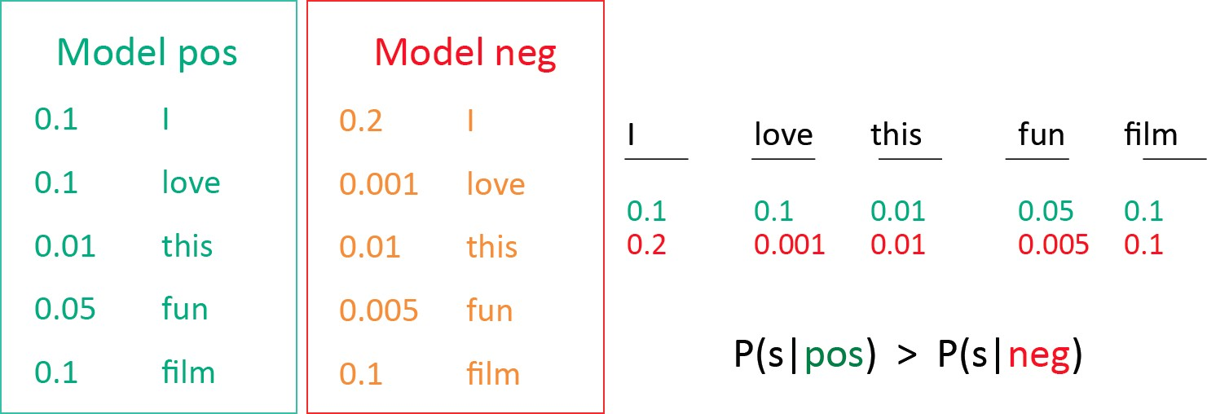
Which class assigns a higher probability to the sentence?
Naïve Bayes as Language Modeling
Text Classification - II
Week 11, Lecture 5

Slide 45
Naïve Bayes: More than Two Classes
Multi-value classification
A document can belong to 0, 1 or > 1 classes
Handling Multi-value classification
For each class c ∈ C, build a classifier γ_{c} to distinguish c from all other classes c′ ∈ C
Given test-doc d, evaluate it for membership in each class using each γ_{c}
d belongs to any class for which γ_{c} returns true
Text Classification - II
Week 11, Lecture 5
10 / 15

Slide 46
Naïve Bayes: More than Two Classes
One-of or multinomial classification
Classes are mutually exclusive: each document in exactly one class
Binary classifiers may also be used
For each class c ∈ C, build a classifier γ_{c} to distinguish c from all other classes c′ ∈ C
Given test-doc d, evaluate it for membership in each class using each γ_{c}
d belongs to one class with maximum score
Text Classification - II
Week 11, Lecture 5
11 / 15

Slide 47
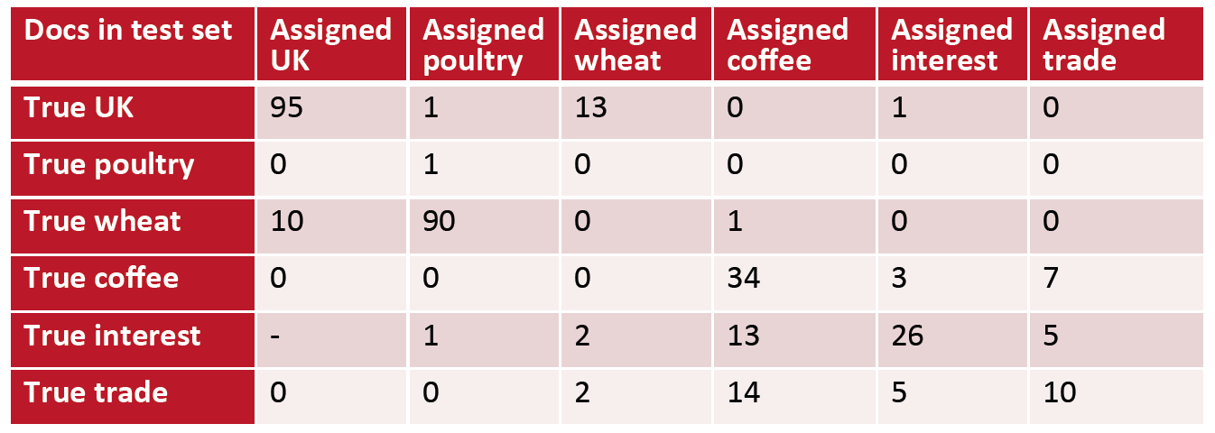
Evaluation: Constructing Confusion matrix c
For each pair of classes < c₁, c₂ > how many documents from c₁ were incorrectly assigned to c₂? (when c₂ =/ c₁)
Text Classification - II
Week 11, Lecture 5

Slide 48
Per class evaluation measures
Recall
Fraction of docs in class i classified correctly: ^{cii}
∑^{c}ij
j
Precision
Fraction of docs assigned class i that are actually about class i: ^{cii}
∑^{c}ji
i
Accuracy
∑^{c}ii
i
N
Fraction of docs classified correctly:
Text Classification - II
Week 11, Lecture 5
13 / 15

Slide 49
Micro- vs. Macro-Average
If we have more than one class, how do we combine multiple performance measures into one quantity?
Macro-averaging
Compute performance for each class, then average
Micro-averaging
Collect decisions for all the classes, compute contingency table, evaluate.
Text Classification - II
Week 11, Lecture 5
14 / 15

Slide 50
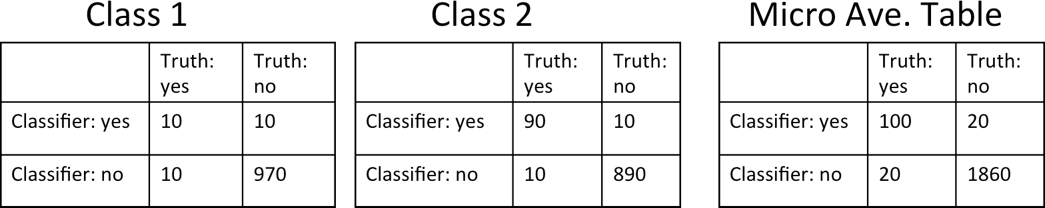
Micro- vs. Macro-Average
Macro-averaged precision: (0.5 + 0.9)/2 = 0.7 Micro-averaged precision: 100/120 = 0.83
Micro-averaged score is dominated by score on common classes
Text Classification - II
Week 11, Lecture 5
15 / 15

